Slide 1
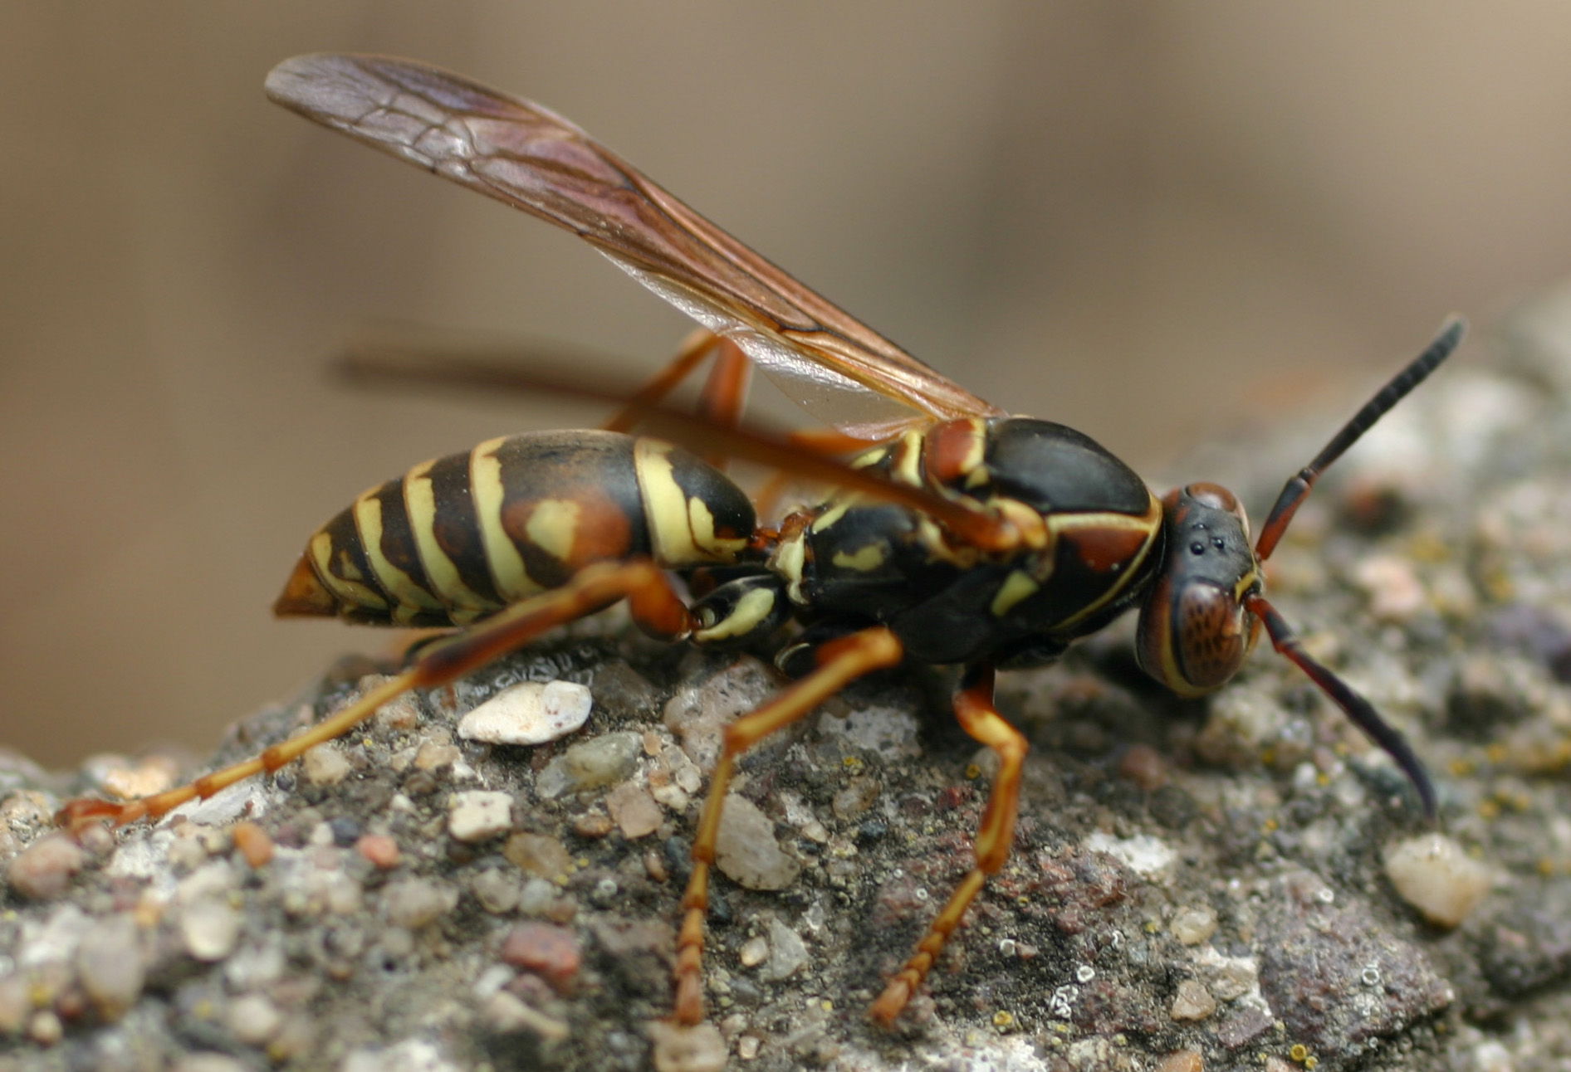
Northern Paper Wasp (Polistes fuscatus)
Wasps

Slide 2
Northern Paper Wasp (Polistes fuscatus)

Slide 3
Northern Paper Wasp (Polistes fuscatus)

Slide 4
Northern Paper Wasp (Polistes fuscatus)

Slide 5
Northern Paper Wasp (Polistes fuscatus)

