Slide 1
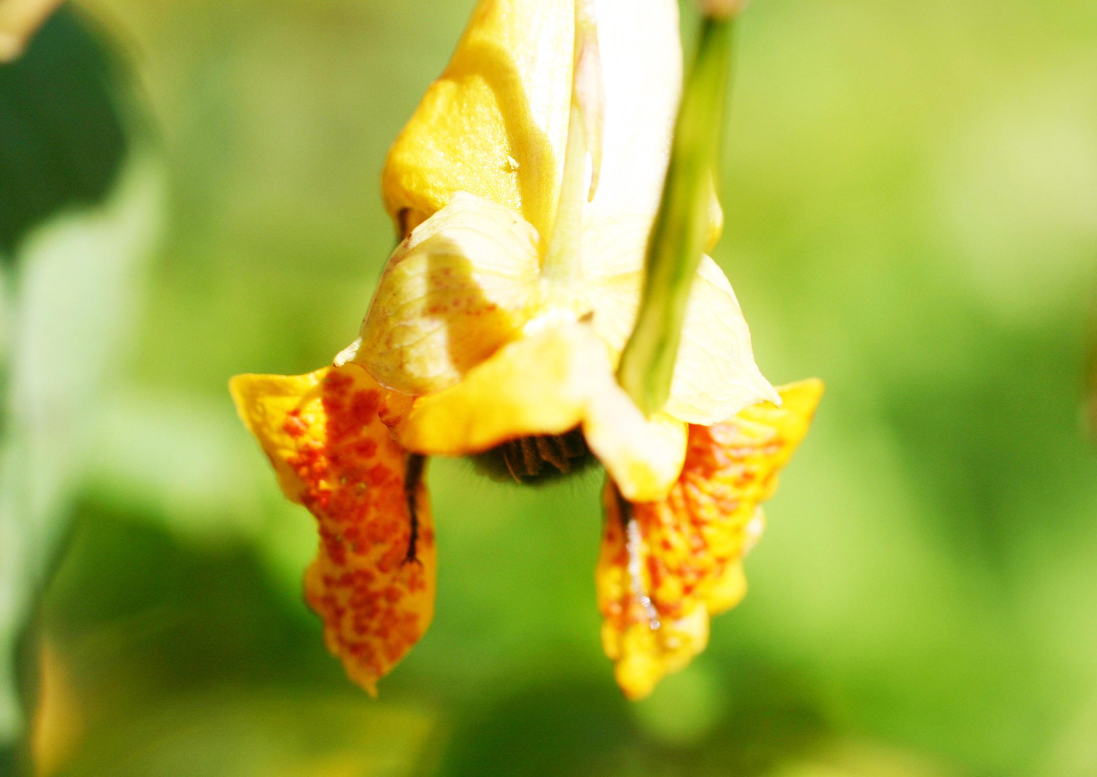
Pollination

Slide 2
Pollination
When a bee beats its wings rapidly, that causes vibrations in the air. Our human ears hear those vibrations as buzzing. The bigger the bee, the slower its wings beat.
When bumblebees or other pollinating bees come to a flower, the buzzing vibrations of the wings and bodies cause pollen in the flower to shake loose.

Slide 3
Pollination
The pollen may stick to the hairy body and be carried to another flower. The bee may put the pollen into its pollen baskets and take it home to make food called beebread.
Some pollen may fly into the air and land on another flower and pollinate it.
Wind also carries pollen from some plants to others of the same species.

Slide 4
