Slide 1
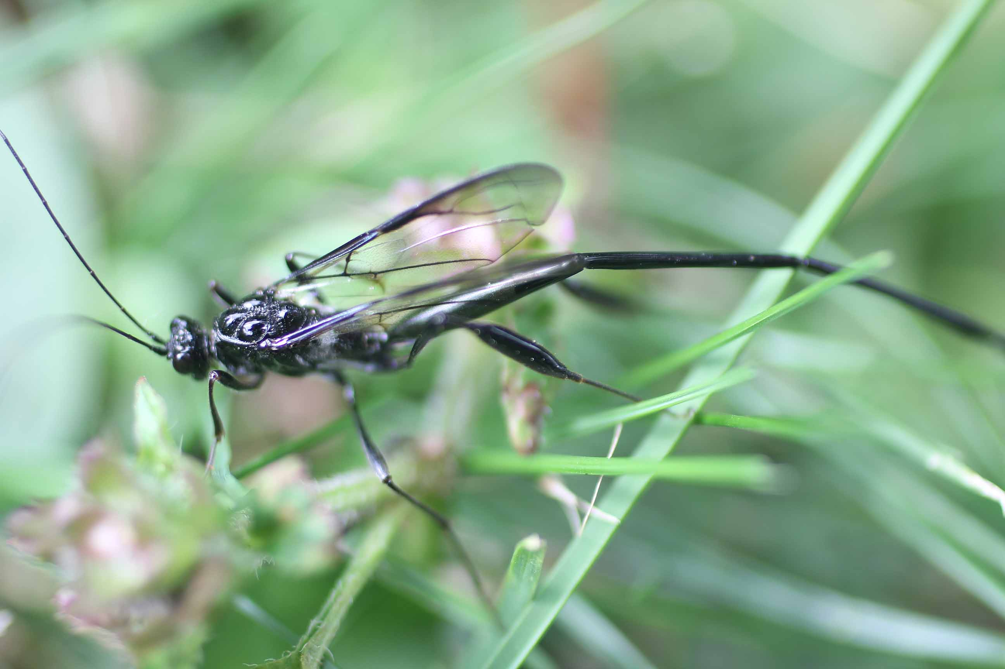
Pelecinid Wasp

Slide 2
Pelecinid Wasp

Slide 3
Pelecinid Wasp

Slide 4
Pelecinid Wasp

Slide 5
Pelecinid Wasp

Slide 6
Pelecinid Wasp
This wasp lays eggs in the ground and develops there.

Slide 7
Pelecinid Wasp

Slide 8
Pelecinid Wasp

Slide 9
Pelecinid Wasp

Slide 10
Pelecinid Wasp

