Slide 1
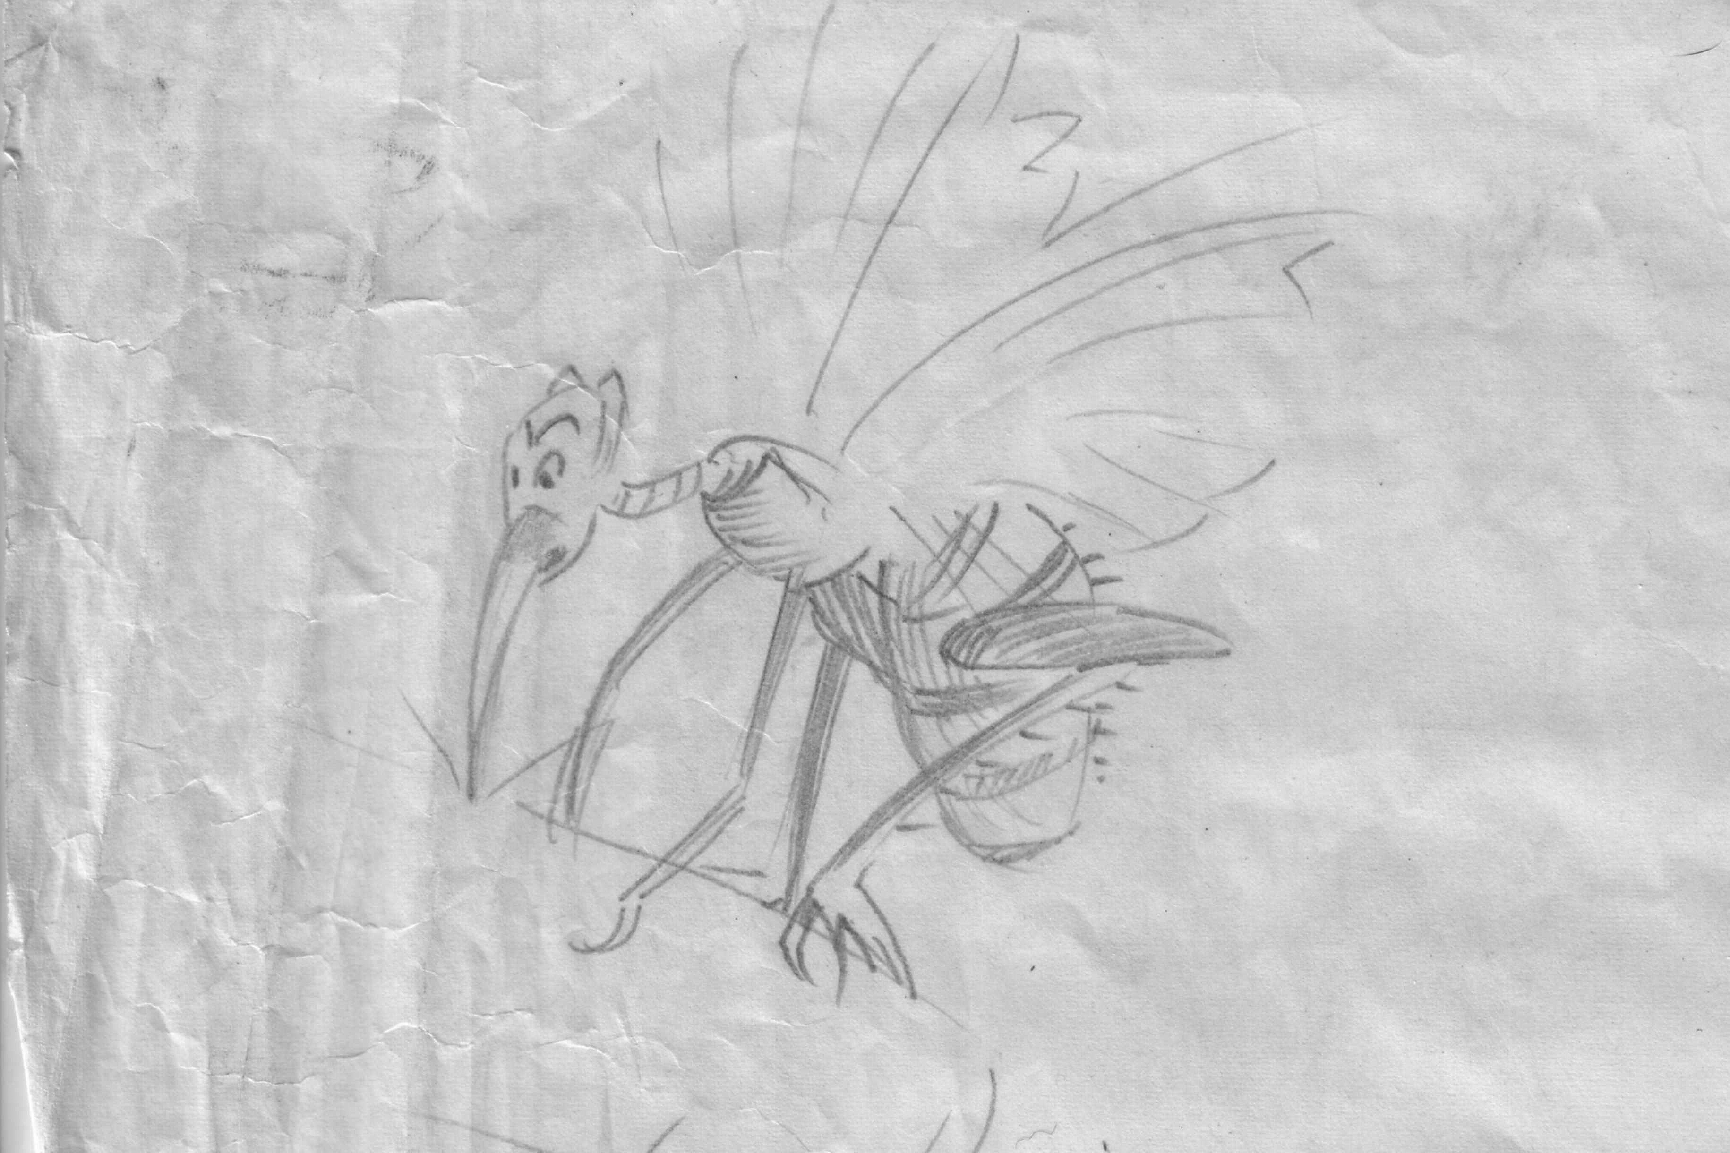
Mosquitoes Walter Kuse drew this picture of a Mosquito.

Slide 2
A Mosquito on Fruit

Slide 3
A Male Mosquito (Note the furry antennae.)

Slide 4
A Young Mosquito in Water

Slide 5
A Mosquito Stinging Through Clothing

