Slide 1
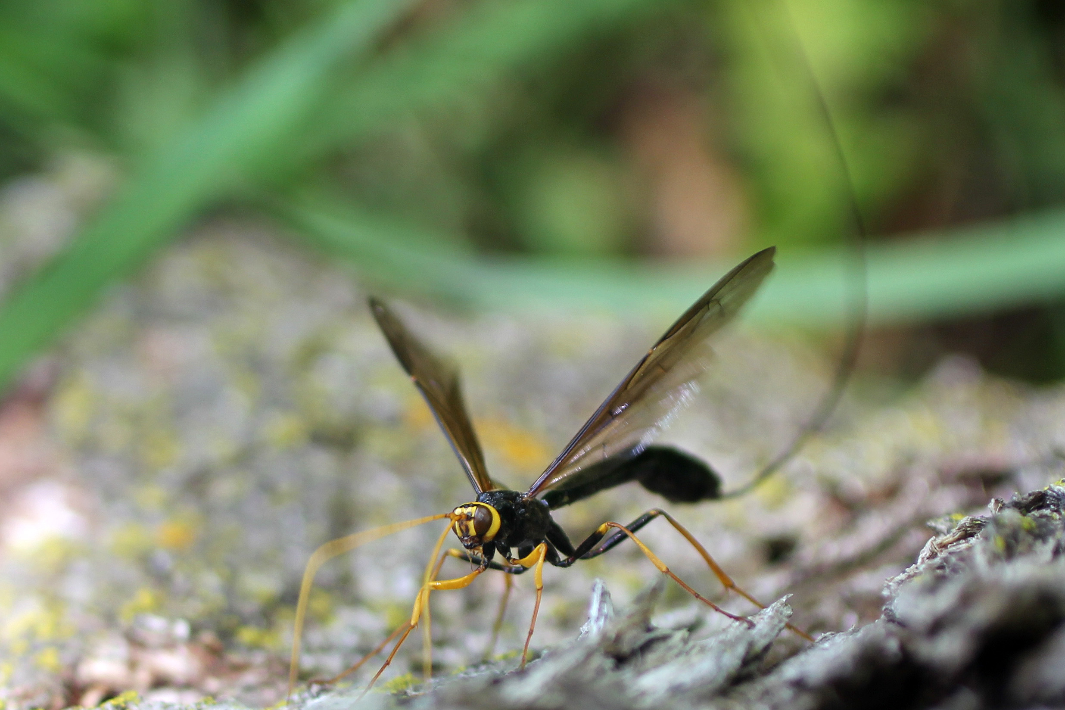
Ichneumon Wasp
Notes:
Ichneumon Wasp
In 2012 our large, beautiful bitternut tree by the house was dead. We had pieces of the logs moved to an area east of the Ohio Buckeye tree. In time the logs rotted and another insect laid eggs inside the logs. An Ichneumon Wasp found the larvae that developed from the eggs. The wasp pierce the developing larvae. Loretta video taped the wasp as it pierced the larvae. To do so it had to have a special part of its body pump liquid into the larvae. Loretta found it just as it was engaged in this process.

Slide 2
Ohio Buckeye Logs

Slide 3
In 2012, our large, beautiful bitternut tree by the house was dead. We had pieces of the logs moved to an area east of the Ohio Buckeye tree. In time, the logs rotted and another insect laid eggs inside the logs.

Slide 4
Ichneumon Wasp

Slide 5
Wasp that Pierced Larvae
An Ichneumon Wasp found the larvae that developed from the eggs. The wasp pierced the developing larvae.

Slide 6
Ichneumon Wasp

Slide 7
Wasp Pumping Liquid into Larvae
Loretta videotaped the wasp as it pierced the larvae. To do so it had to have a special part of its body pump liquid into the larvae. Loretta found it just as it was engaged in this process.

Slide 8
Ichneumon Wasp

