Slide 1
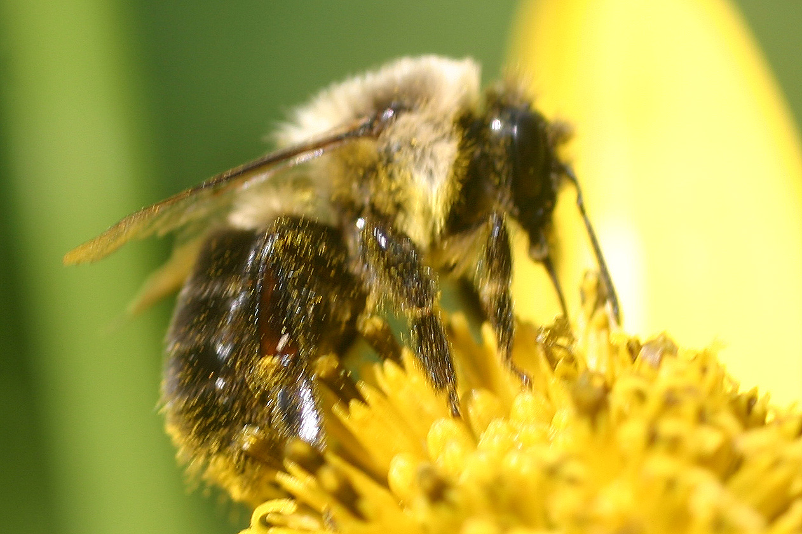
Bumblebees

Slide 2
Bombus Ternarius Tricolored
Bumblebee

Slide 3

Bumblebee

Slide 4
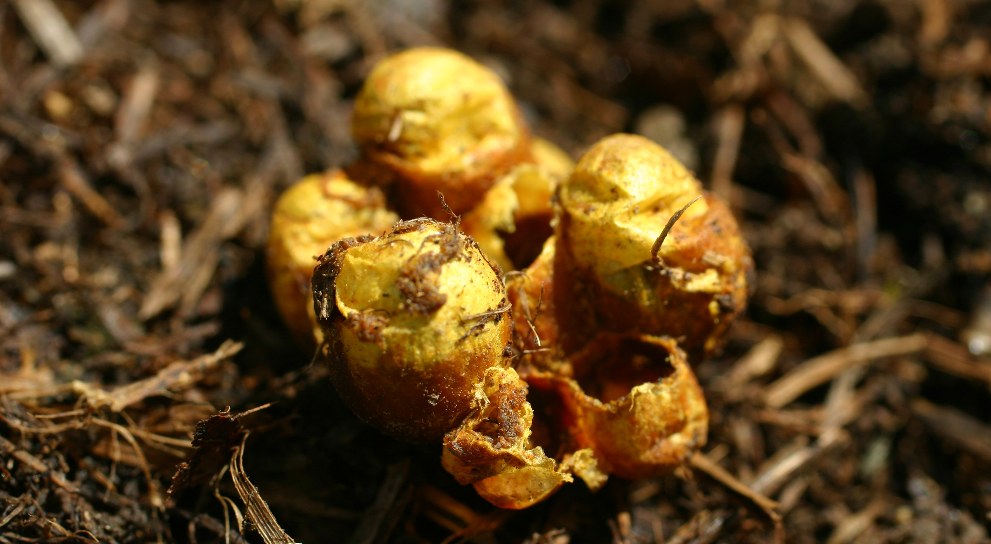
Bumblebee Nest

Slide 5
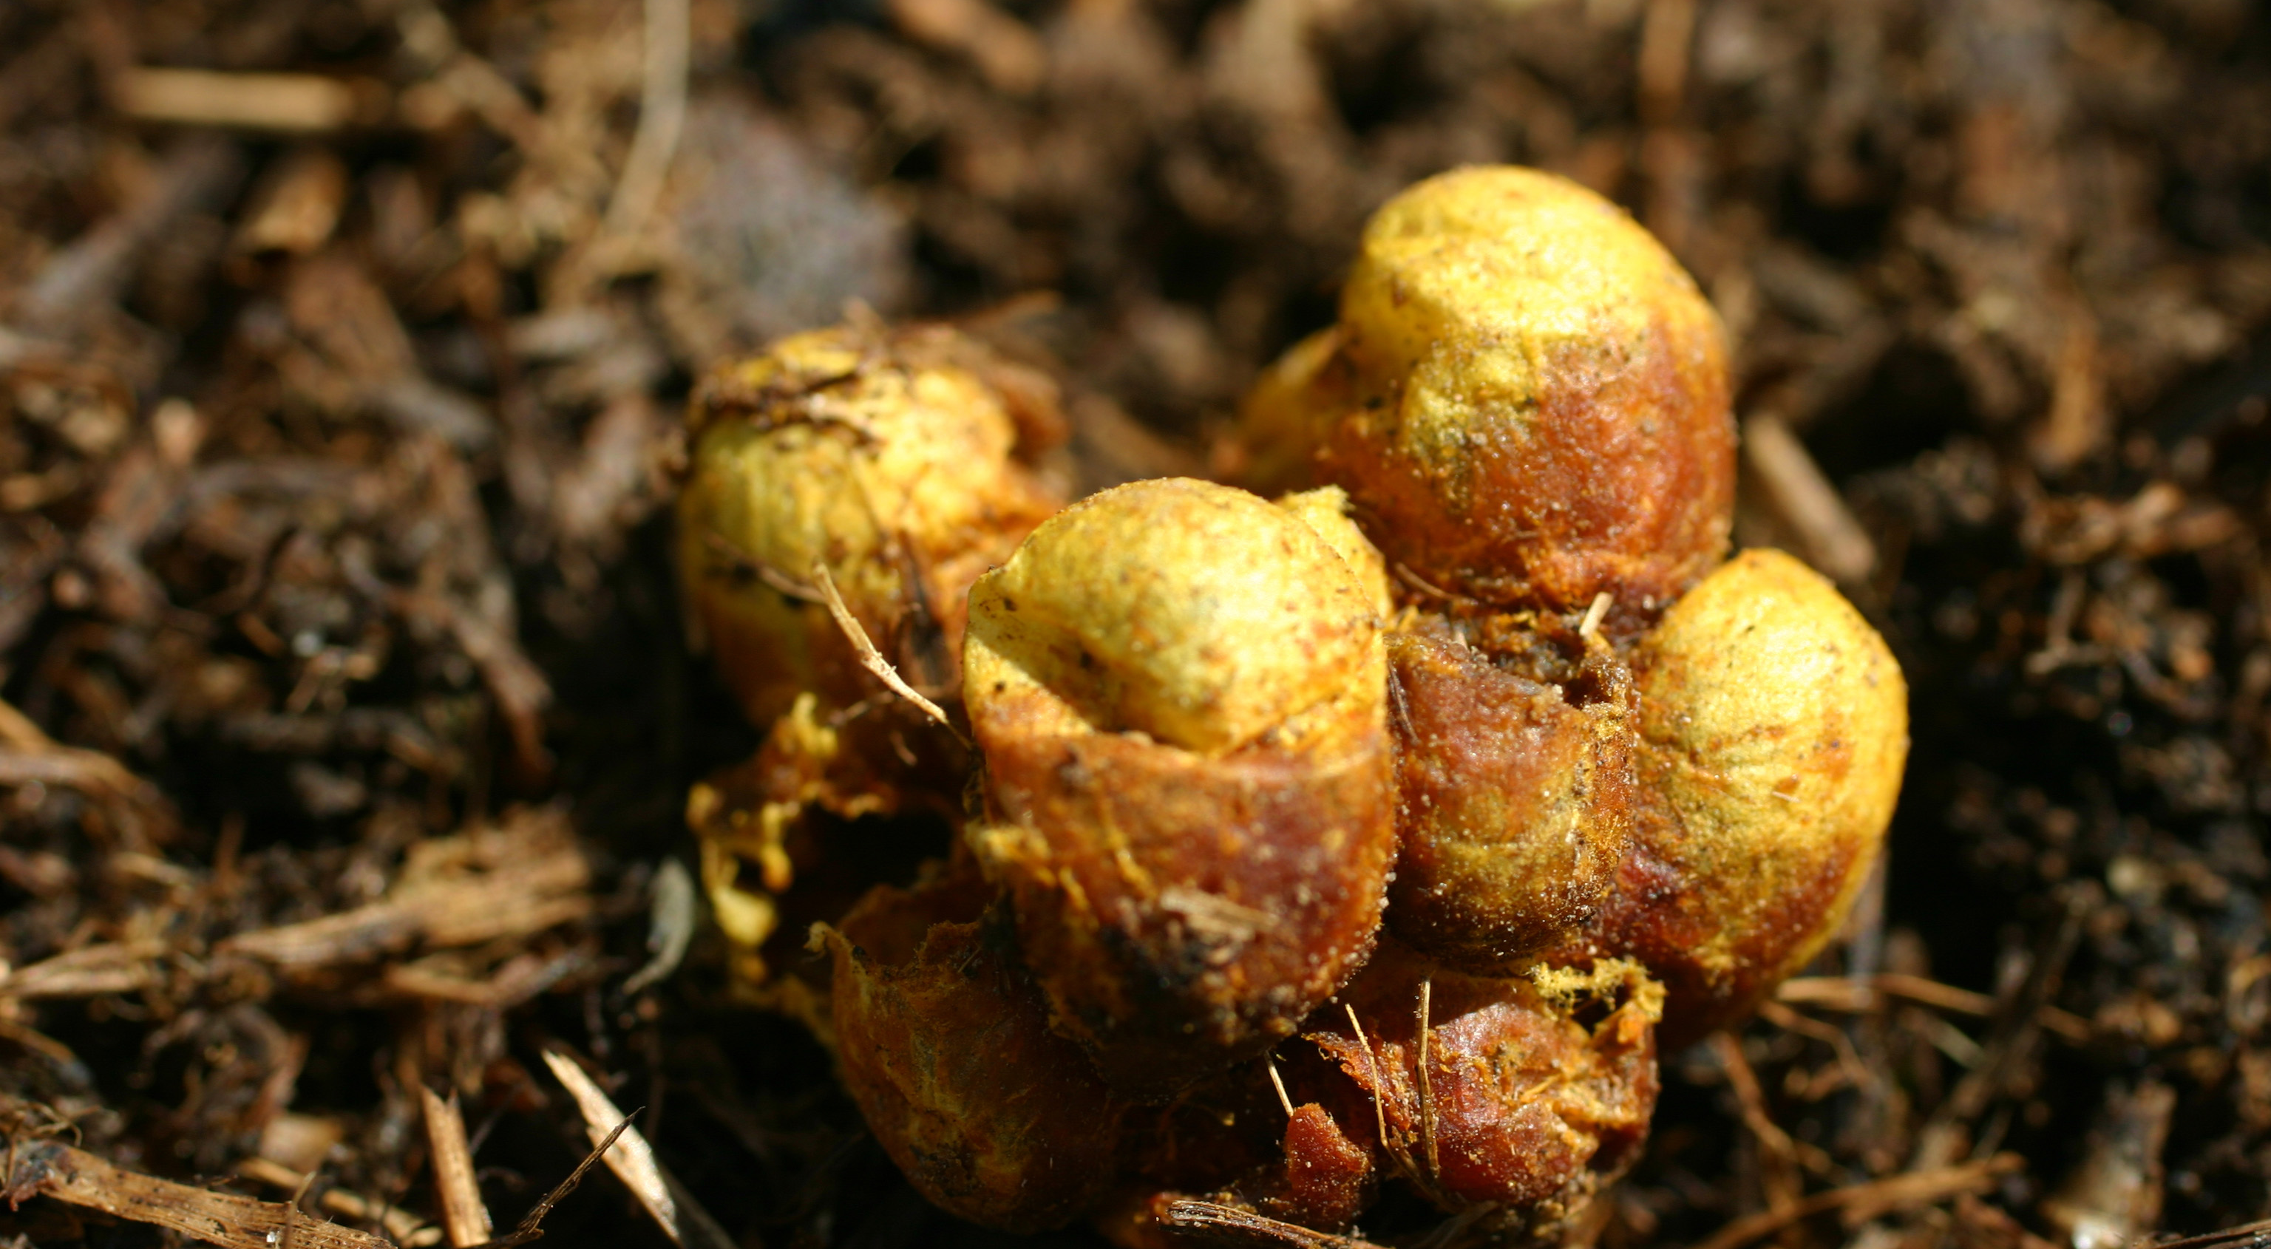
Bumblebee Nest

Slide 6
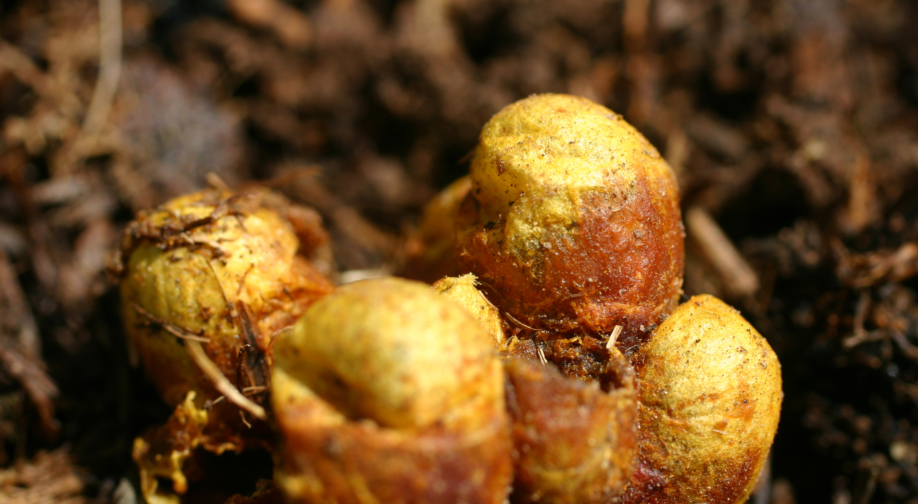
Bumblebee Nest

Slide 7
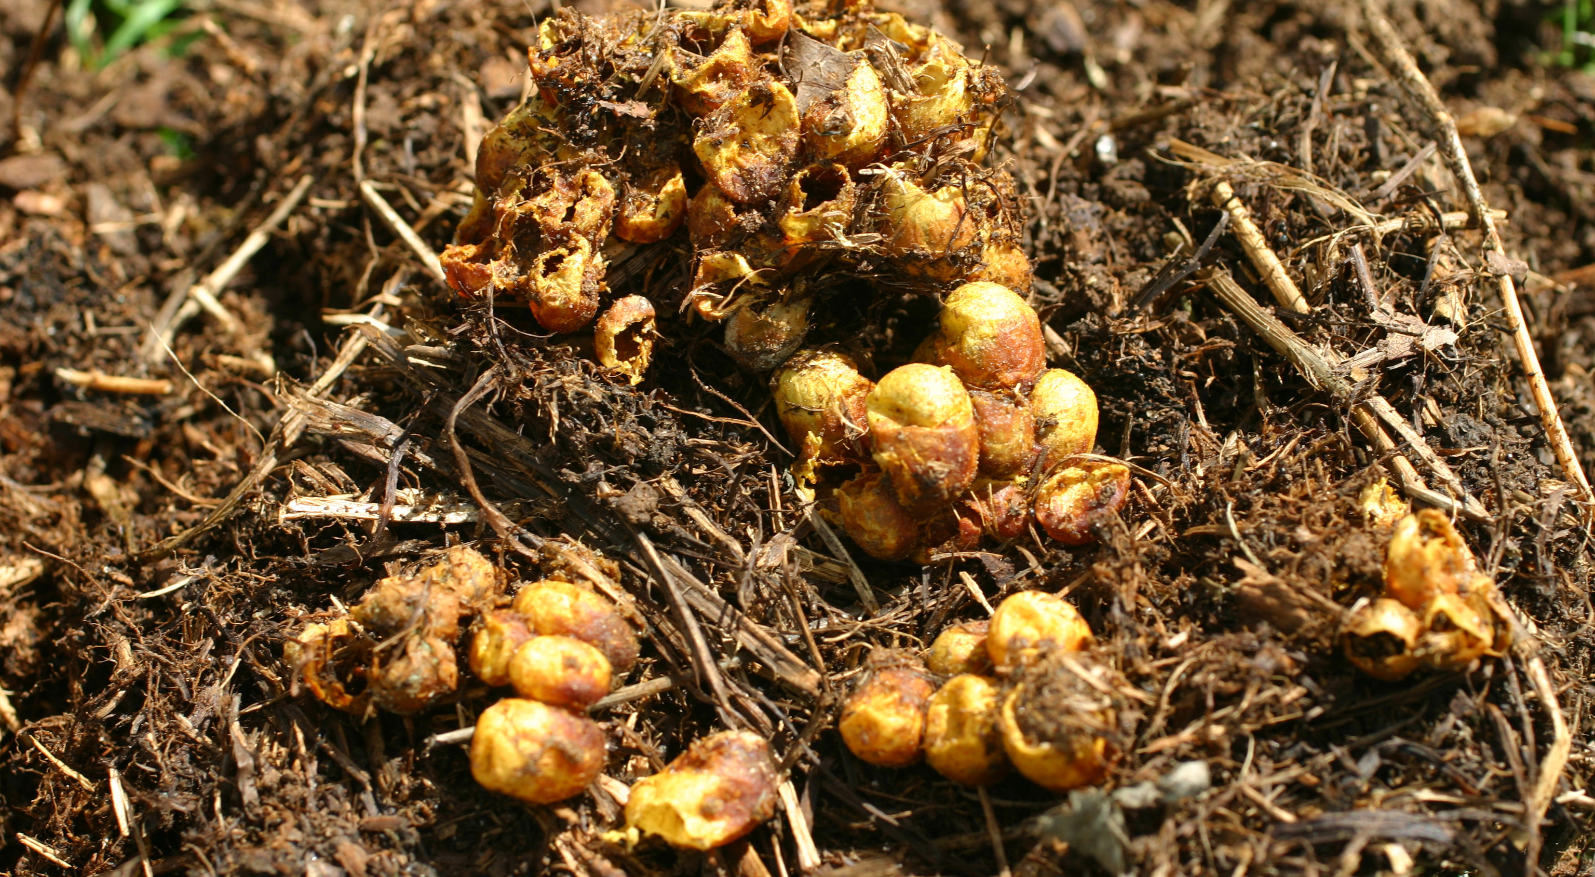
Bumblebee Nest

Slide 8
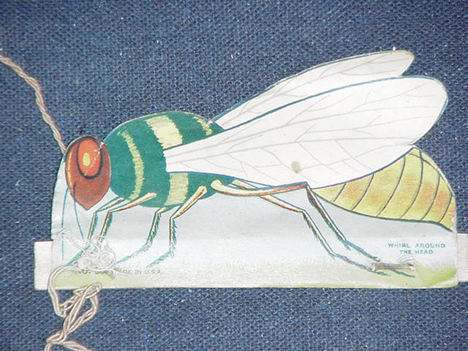
A Child’s Toy Included in a Cereal Box in the 1940’s. Whirling it Around Made it Buzz.

Slide 9
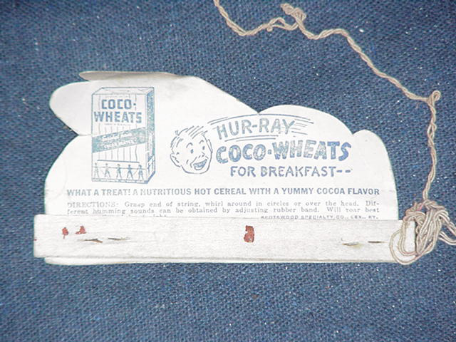
A Child’s Toy Included in a Cereal Box in the 1940’s. Whirling it Around Made it Buzz.

