Slide 1
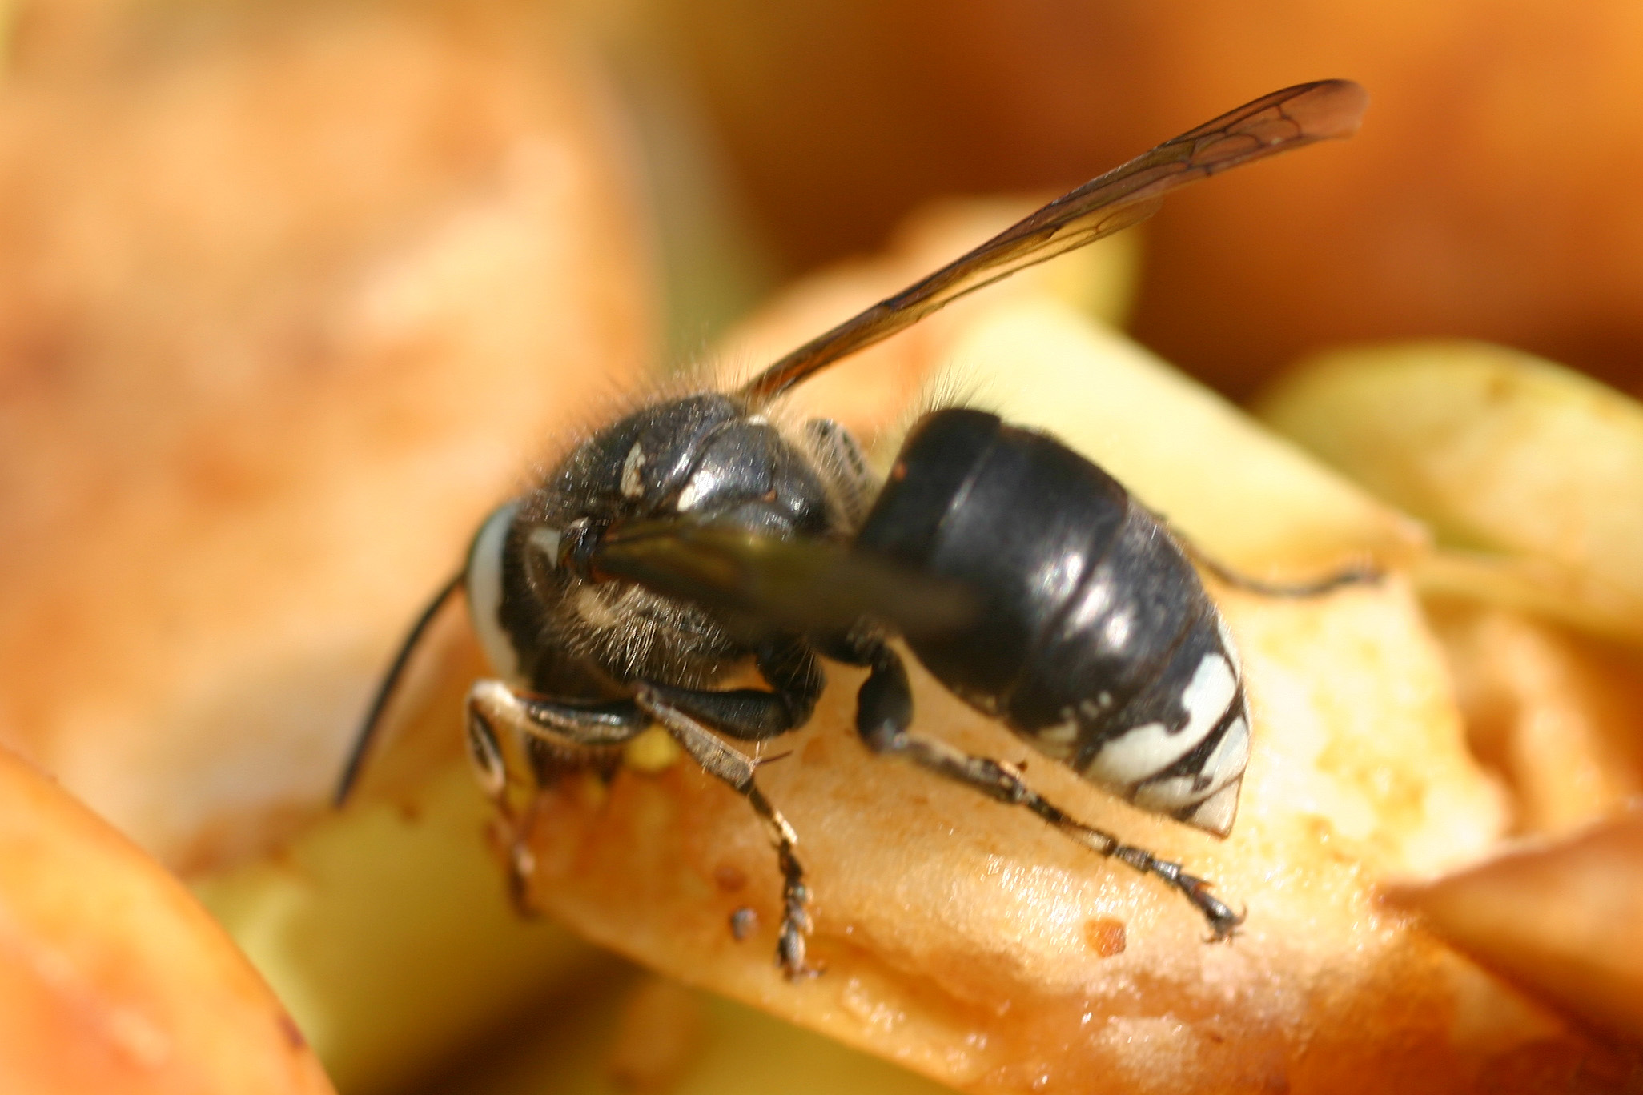
Bald Faced Hornet

Slide 2
Bald Faced Hornet Nest With a Long Tube for Entrances

Slide 3
Bald Faced Hornet
2002 - June 23 - July 14
Bald-faced hornet nest with long tube and hornet going in and out
Bald-faced hornets' nest at home of Linda Frischman's daughter

Slide 4
Bald Faced Hornet

Slide 5
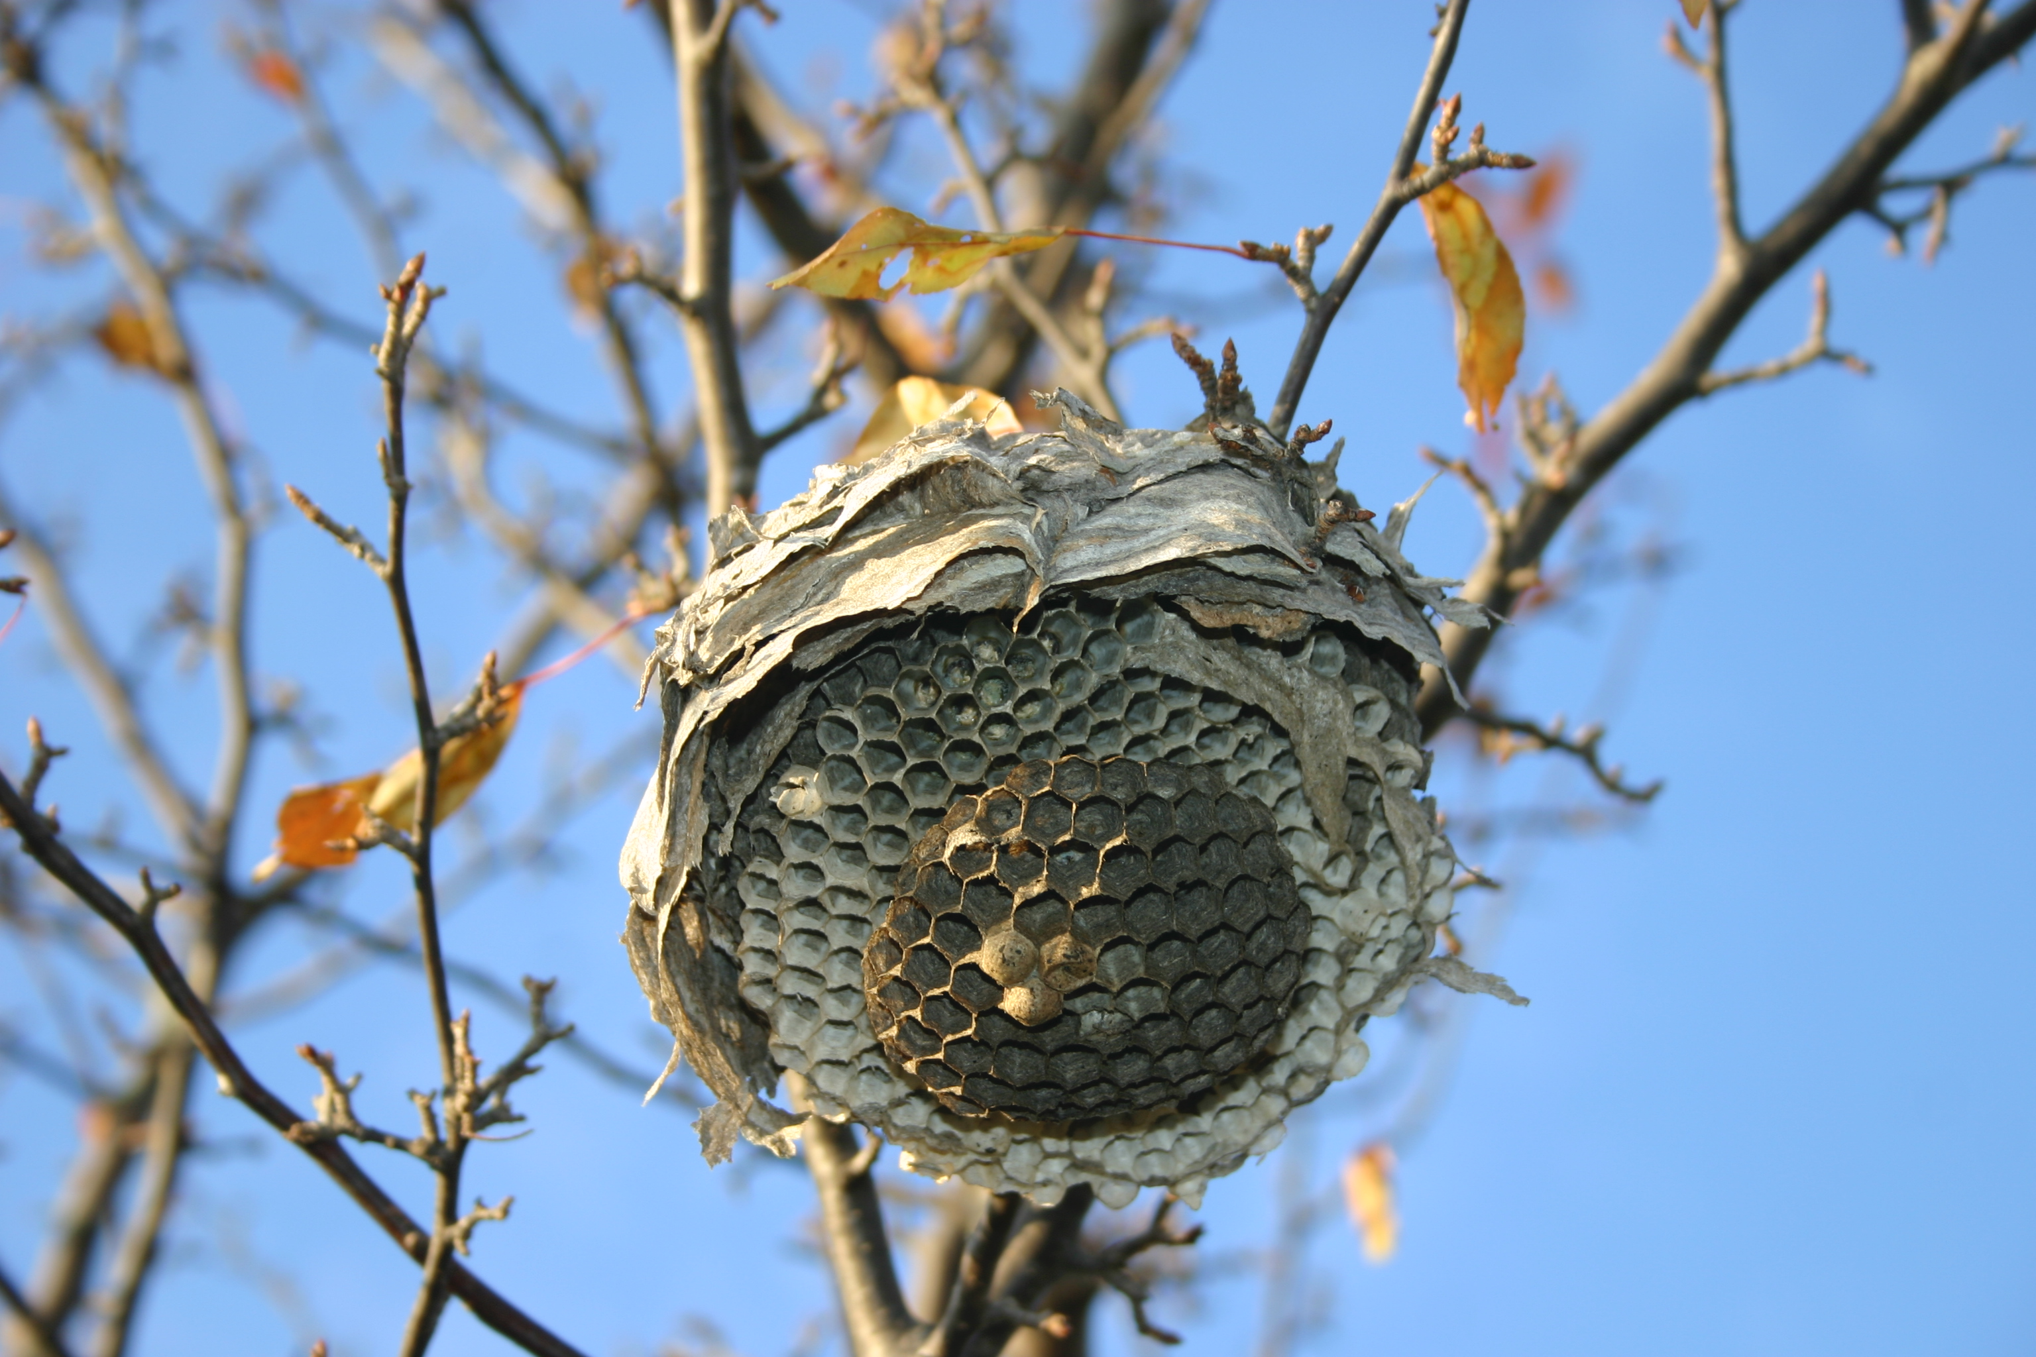
Bald Faced Hornet in Apple Tree

Slide 6
Barn Boards From Which Wood Has Been Shaved to Make Nests

Slide 7
Bald Faced Hornet in Maple Tree

Slide 8
Bald Faced Hornet Nest in Basswood Tree

Slide 9
Part of a Bald Faced Hornet Nest

Slide 10
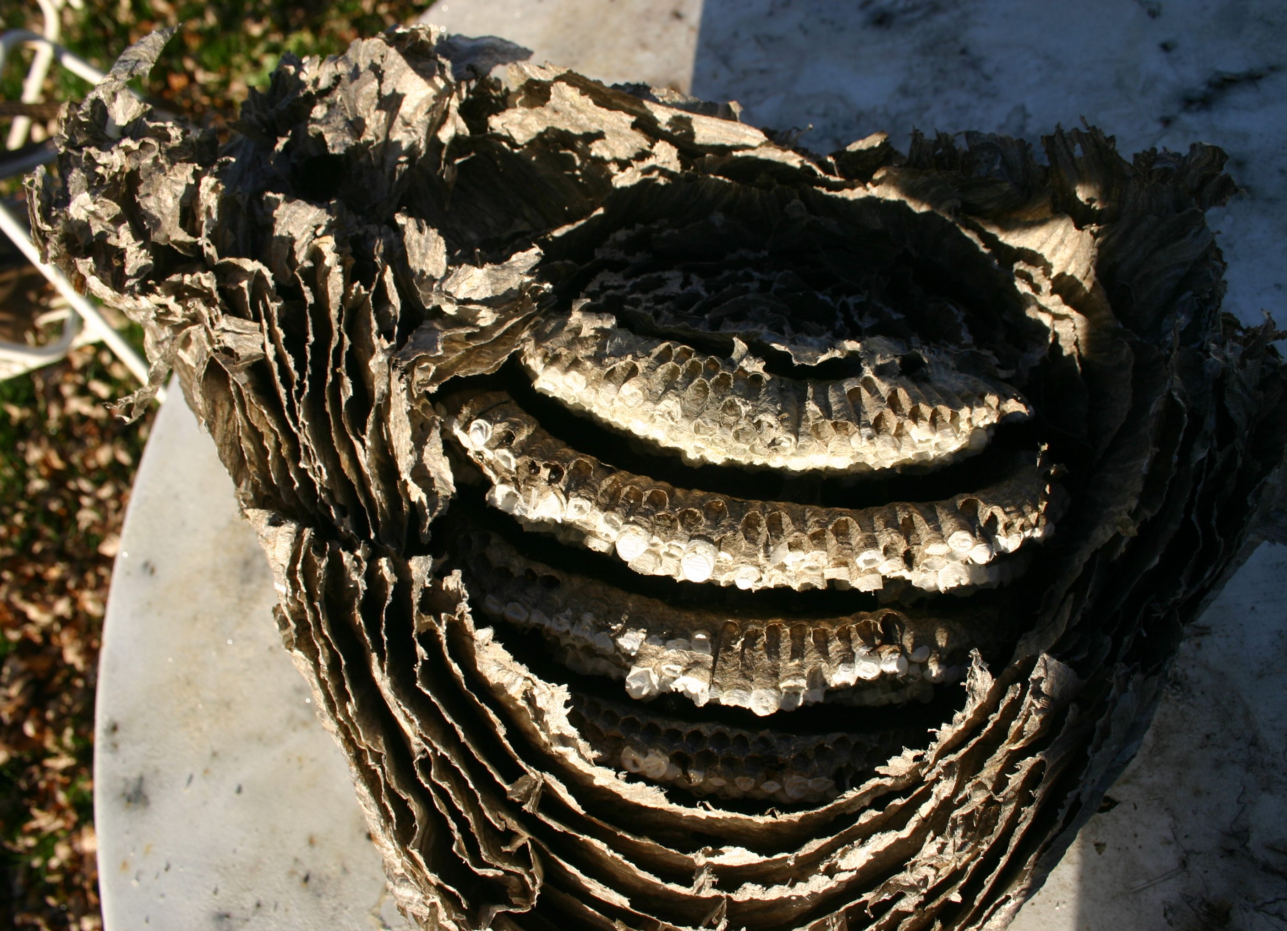
Part of a Bald Faced Hornet Nest

Slide 11
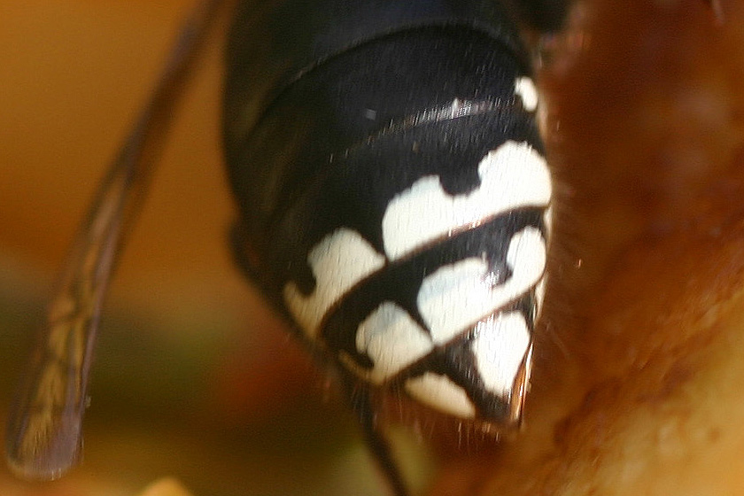
Bald Faced Hornets Can Sting

